Slide 1
Conducting Open Science using R and DataONE: A Hands-on Primer Workshop at ESA Annual Meeting Aug 4, 2013
Matt Jones, NCEAS/UCSB and DataONE
Mark Schildhauer, NCEAS/UCSB and DataONE
Carl Boettiger, UC Santa Cruz and rOpenSci initiative
Karthik Ram, UC Berkeley and rOpenSci Initative
Notes:
What is the experience of attendees using either “R” or some data repository? Using any scripted language for analysis, as opposed to GUI-driven application?

Slide 2
Goals of the Workshop
Open Science:
Understanding what it is & why it is important
DataONE:
A data repository for Open Science
R:
A top analysis language for Open Science
Lots of “Hands-on using R with DataONE”:
muscle memory to become a sleek geek

Slide 3
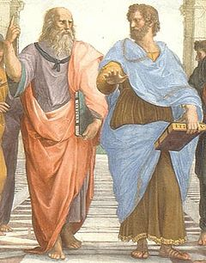
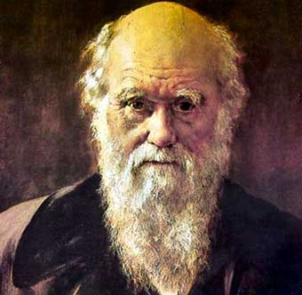
What is Open Science and why do we need it?
“It is therefore thought fit to employ the [printing] press, as the most proper way to gratify those [who]... delight in the advancement of Learning and profitable Discoveries [and who are] invited and encouraged to search, try, and find out new things, impart their knowledge to one another, and contribute what they can to the Grand Design of improving Natural Knowledge... for the Glory of God... and the Universal Good of Mankind.”
Henry Oldenburg, 1665, Philosophical Transactions of the Royal Society
“

Slide 4

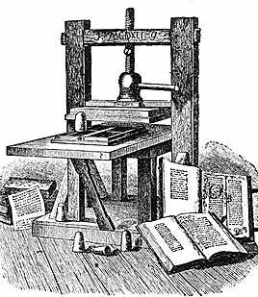
Science is Communicated
Cave-man times to ESA 2013…
…1665 to present…

Slide 5
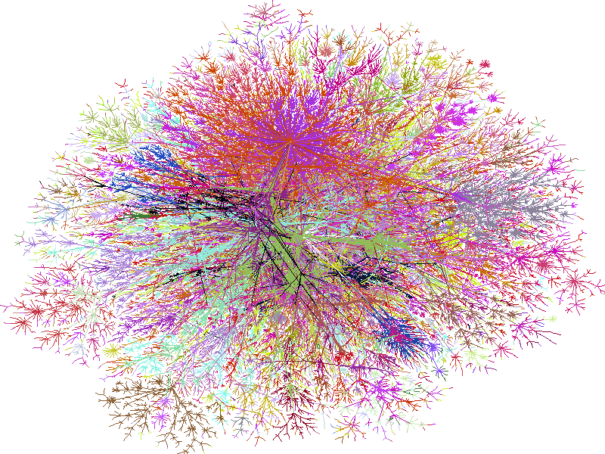
Science is Communicated
+
(
+
)
…1993 to the future…

Slide 6
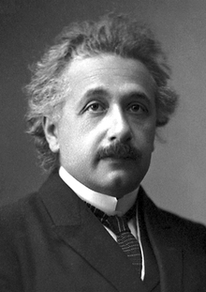
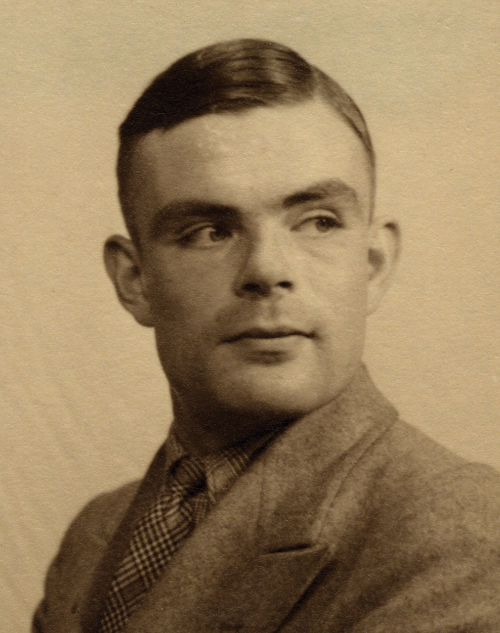
Open Open Science
in the 21st Century
“Scientists should communicate the data they collect and the models they create, to allow free and open access, and in ways that are intelligible, assessable and usable for other specialists in the same or linked fields wherever they are in the world. Where data justify it, scientists should make them available in an appropriate data repository.”
“Science as an open enterprise”, The Royal Society Science Policy Centre report 02/12

Slide 7
Why Open Science now?
Technology is available to do it (Internet + Web + FLOPS)
Growing politicization of science: need for transparency
Importance of large-scale/interdisciplinary science
Efficiencies in re-using or sharing available data, code
A return to fundamental premise of science: objective, repeatable, replicable, general
Notes:
~10 TFLOPS on the desktop today; ~35 PFLOPS on HPC

Slide 8
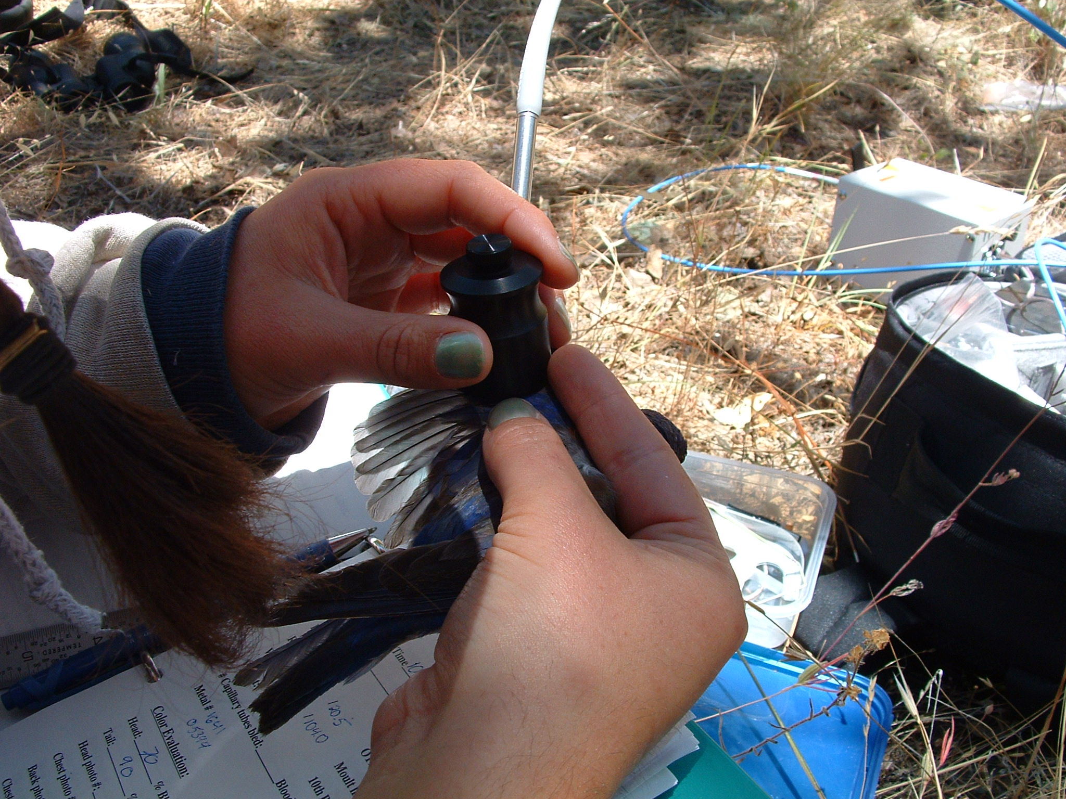
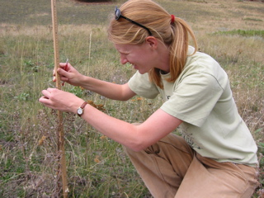
Why Open Science for Ecology?
Need to answer increasingly complex and societally-relevant
questions about the environment:
are the world’s fisheries sustainable?
how will climate change impact global food production?
are GMO crops safe to introduce to the environment?
why are pollinators declining around the world?
will nanotech wastes alter ecosystems?
what will be impacts of ocean acidification on reef corals?
can we predict the spread of invasive species and disease?

Slide 9
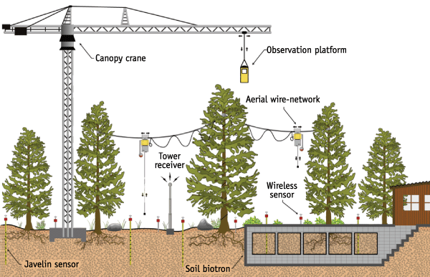
…and these analyses require a wide range of DATA
Broad scales: geospatial, temporal, and biological
Micro (and nano) to Global
Diverse topics: abiotic and biotic measurements and their contexts
land-use/land-cover, geology, soils,
atmosphere, hydrology, oceanography
genes to ecosystems
human sciences: culture & traditions, demographics, economics, governance

Slide 10
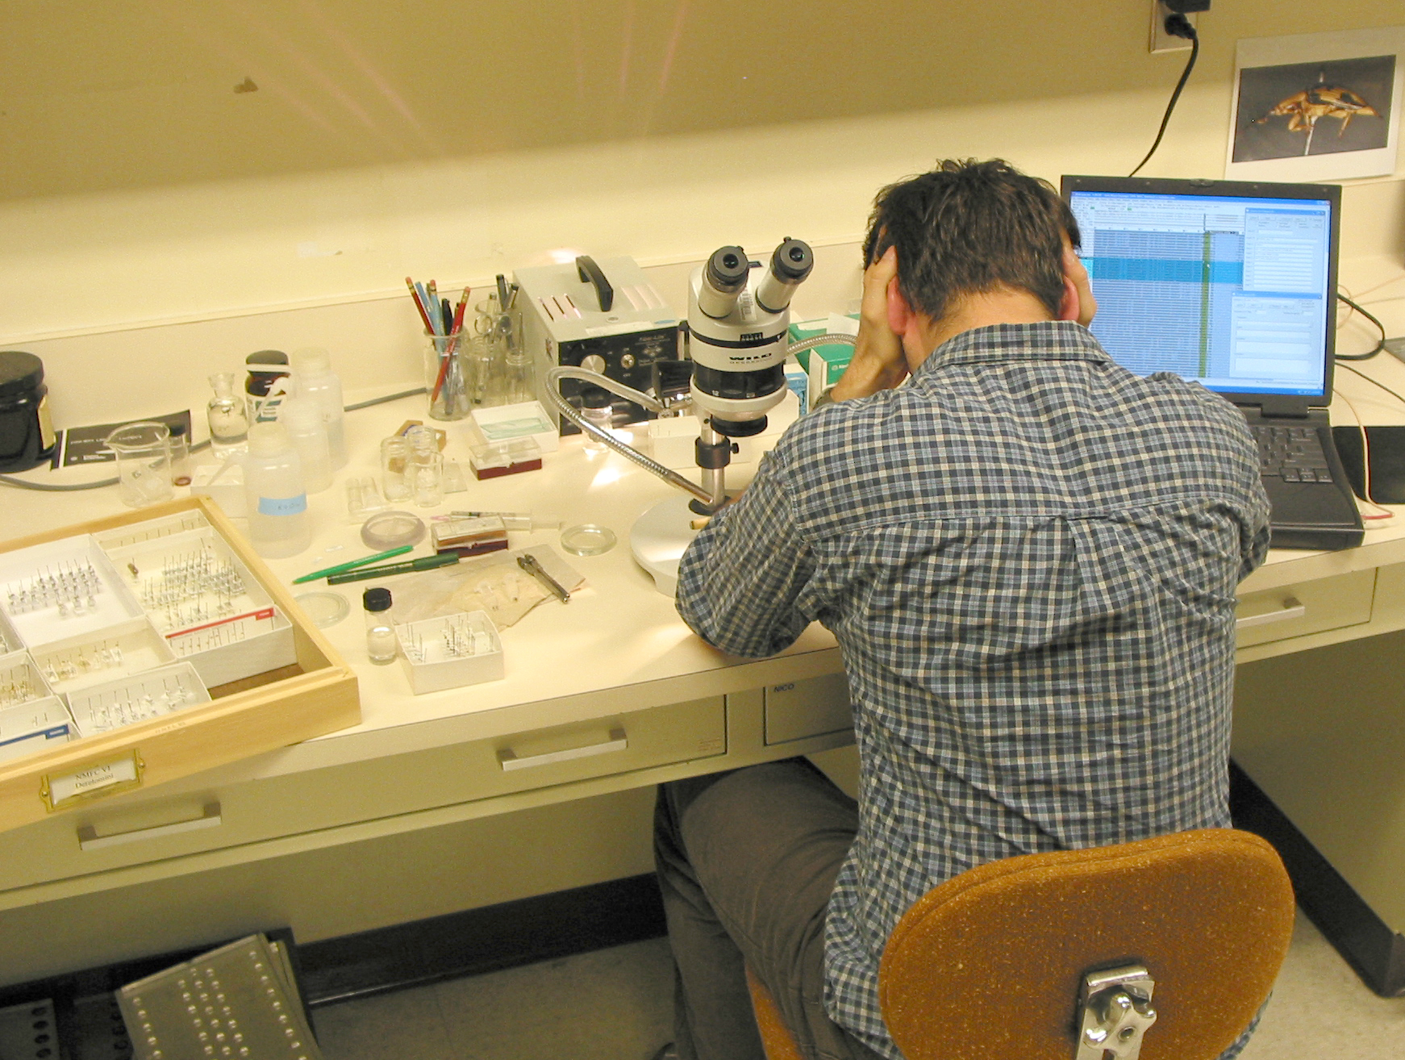
Fundamental Problem: Big Data
Ecological/biodiversity data are Big Data:
globally distributed, voluminous
highly heterogeneous in structure and content
rapidly growing!
i.e., the 3 “V”s:
Volume
Variety
Velocity

Slide 11
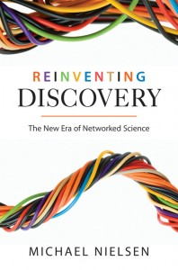
Open Science for Ecology
Collaborate to provide complementary expertise
Share data to increase scope and robustness of results
Leverage micro-expertise
Amplify collective intelligence

Slide 12
Open Science:
Open Access: journals (e.g PLoS)
Open Data: repositories (e.g. DataONE)
Open Source: code and algorithms (e.g. R)
Open Notebook: blog++ (e.g. iPython)

Slide 13

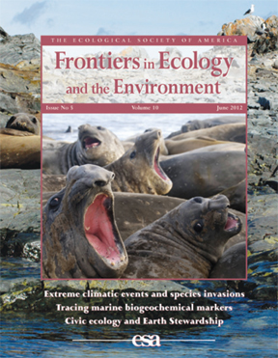
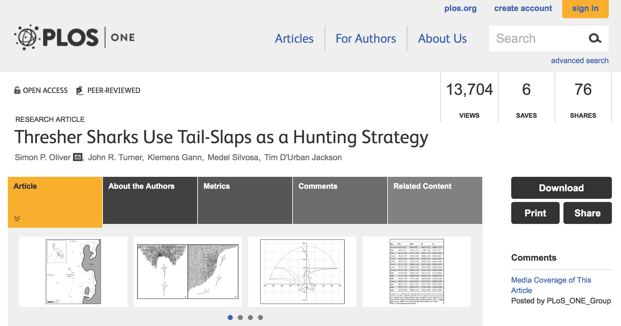
Open Access (OA)
Rapid, highly affordable access to the latest scientific findings
Issues:
Peer-review process
Copyright (IP issues)
Costs
Notes:
Access to scientific research results should be unfettered, and there is now some discussion that it should even be considered a basic “human right”

Slide 14
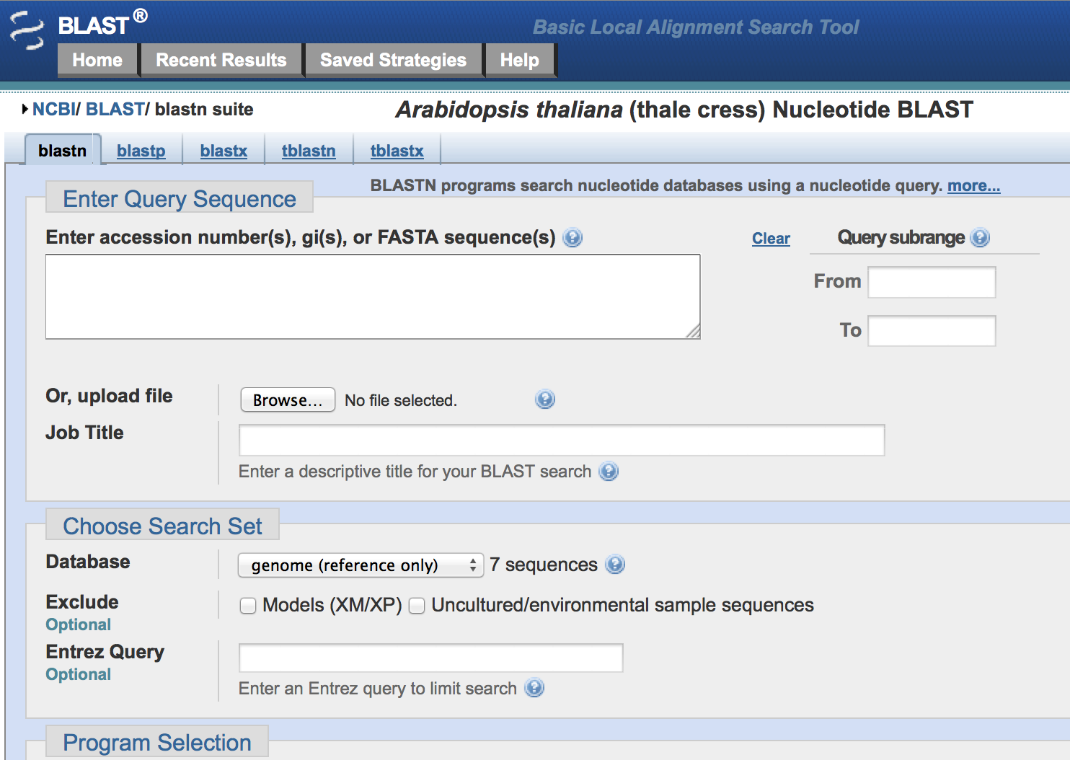
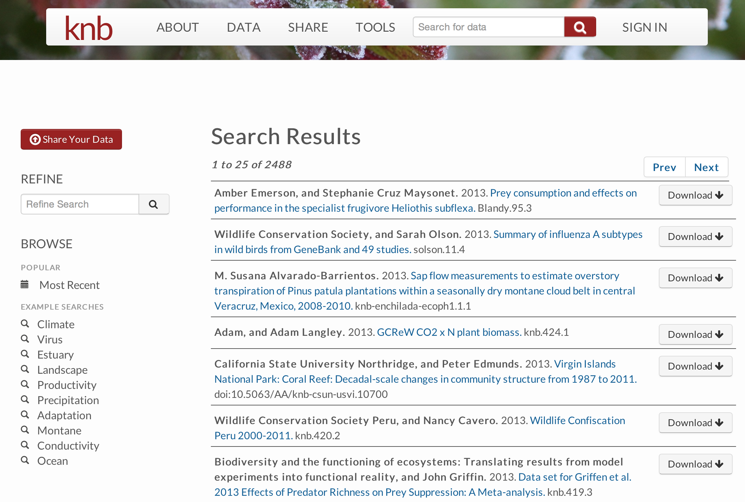
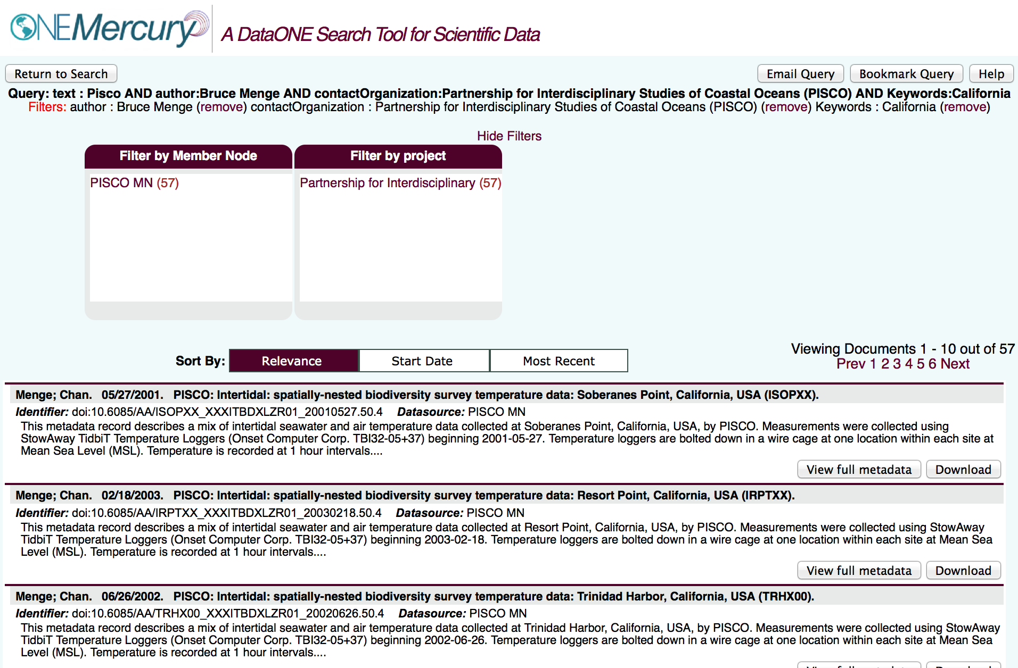
Open Data
Rapid, highly affordable access to ALL the data supporting scientific findings
Notes:
Open Data means providing all the data that support any findings that you report on, and potentially additional data that might be of interest or use to someone else exploring nature

Slide 15
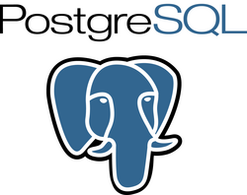


Open Source
Rapid, low-to-no barrier access to the applications, software, algorithms, and code used in an analysis, enabling examination and verification, and ideally suitable for re-use or extension
FOSS: free, open source software (speech)
Freeware: free to use (beer)
Notes:
FOSS enables scientists and/or citizens to participate in research, regardless of their financial circumstances, if they have a computer

Slide 16
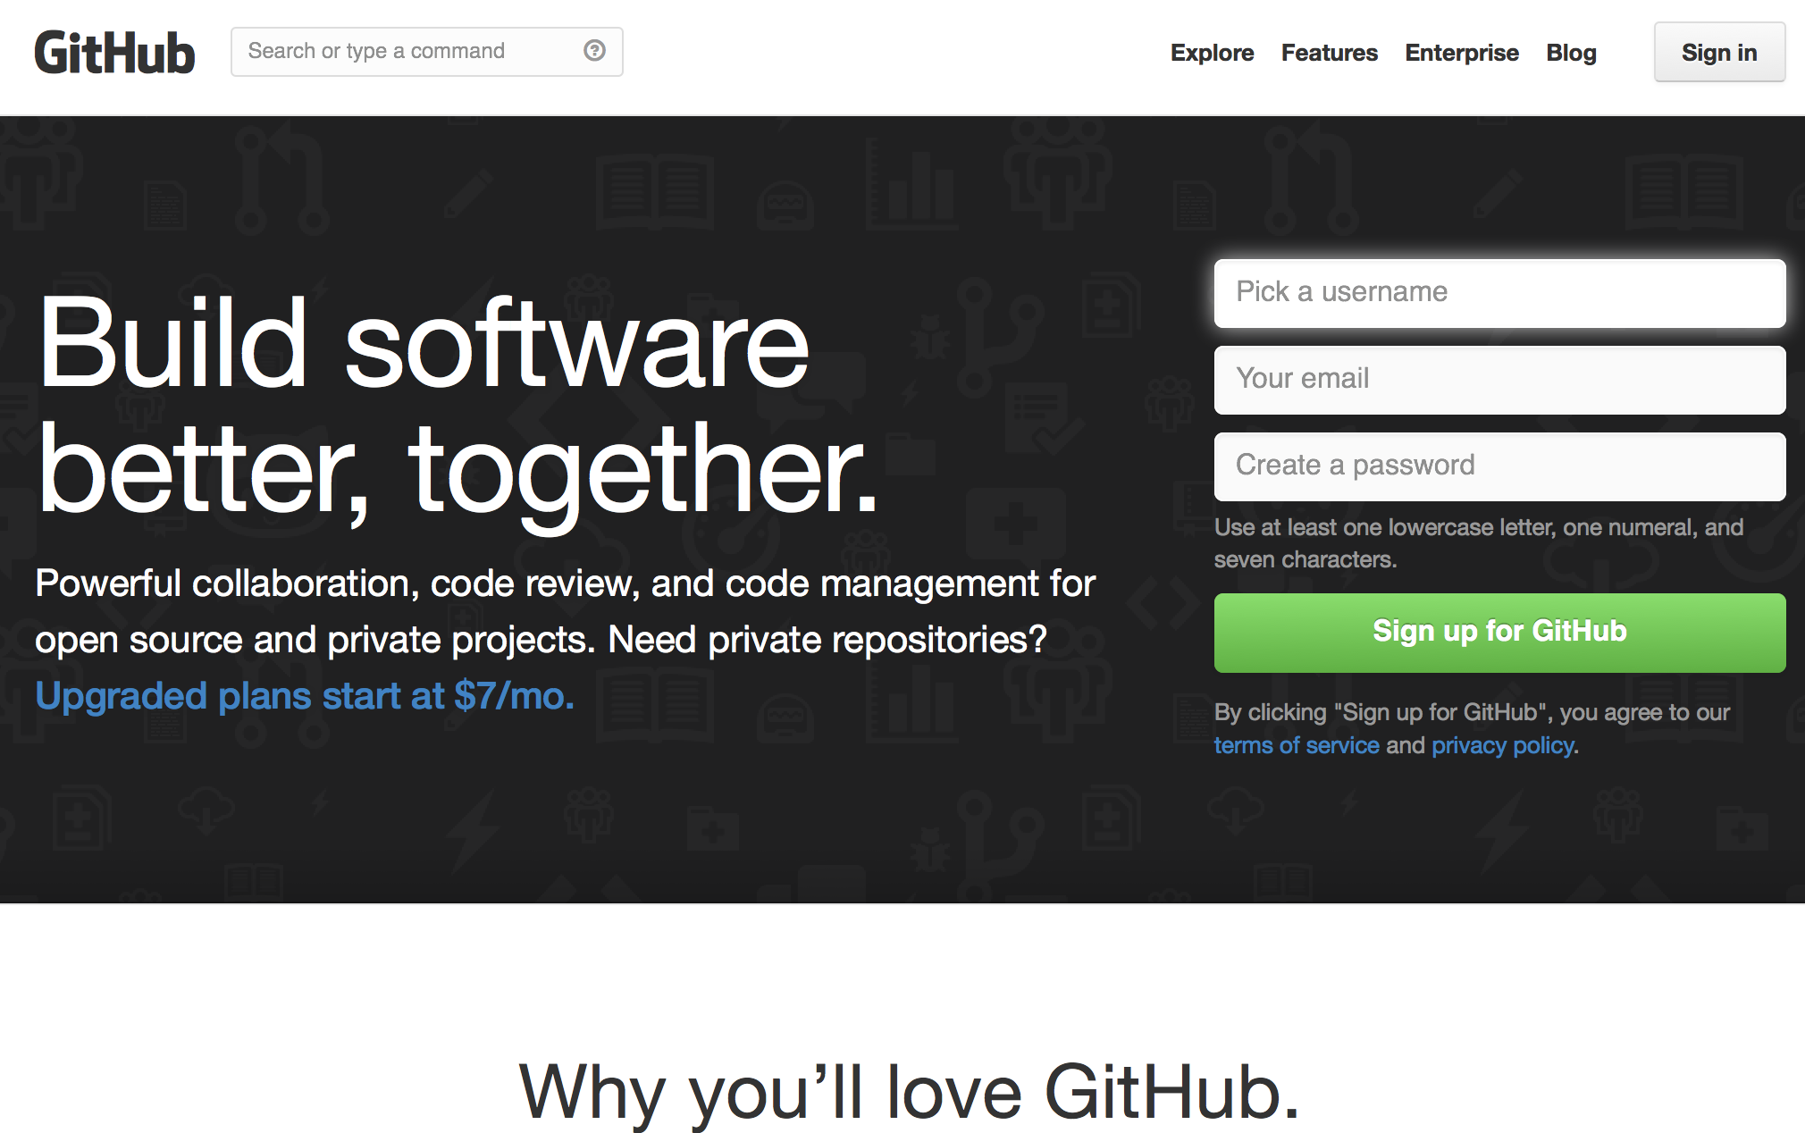
Open Source
Rapid, highly affordable access to the algorithms and other code used in an analysis, to enable examination and verification of appropriateness, and ideally suitable for re-use
Notes:
An environment for collaborative code development

Slide 17
Open Notebook
Rapid, no-to-low barrier access to the design details, logistical considerations, analytical decision points and justifications, anecdotes/marginalia, as well as code, data, visualizations, analyses etc. that support scientific findings
A complete record– accessible, preserved, rich formats, linked, updated

Slide 18
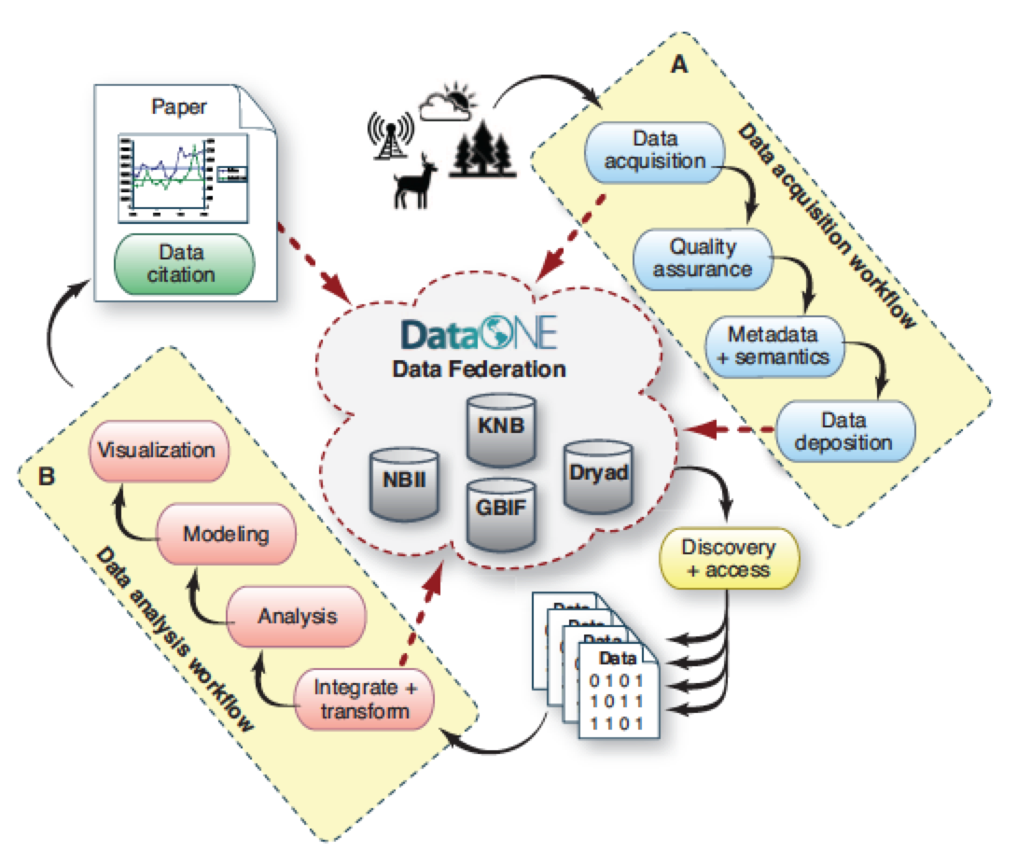
From- Reichman, Jones, Schildhauer (2011) “Challenges and Opportunities of Open Data for Ecology”

Slide 19
DataONE- Data Observation Network for Earth Cyberinfrastructure
A major, ongoing NSF-sponsored Cyberinfrastructure development project, to develop a sustainable digital data repository for our nation’s environmental and ecological research data…

Slide 20












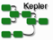
DataONE
Three major components for a flexible, scalable, sustainable network
Member Nodes
diverse institutions
serve local community
provide resources for managing their data
retain copies of data
Coordinating Nodes
retain complete metadata catalog
indexing for search
network-wide services
ensure content availability (preservation)
replication services
Investigator Toolkit
Notes:
DataONE is a federated data network built to improve access to Earth science data, and to support science by:
engaging the relevant science, data, and policy communities;
facilitating easy, secure, and persistent storage of data; and
disseminating integrated and user-friendly tools for data discovery, analysis, visualization, and decision-making.
There are three principal components:
Member Nodes which include a diverse array of data centers and repositories that are associated with national and international agencies and research networks, universities, libraries, etc.
Coordinating Nodes which support data replication across Member Nodes (i.e., data centers) as well as network wide services like 24/7 access to metadata at the CNs, indexing and rapid search and discovery, etc.
Am Investigator Toolkit that includes tools that are widely used by scientists, The tools are coupled with the DataONE resources so that it is, for example, possible to seamlessly and transparently access data at Member Nodes through the tool of your choice.

Slide 21
Data preservation and reuse thru DataONE
Contribute and preserve your data
Search and find others’ data
Collaborate and accelerate your science!
Notes:
These are basically: Too busy; too difficult; no benefit, too weird,

Slide 23
Why “R”*?
FOSS! (unlike SAS, MATLAB, MMA)
Cross-platform (Win, OSX, Linux)
64 & 32 bit versions (for new and old machines)
* http://www.r-project.org/

Slide 24
Why “R”*?
Unix-like: modular, commands “do one thing well”
Strong Community: CRAN, packages
Advanced statistical libraries and visualization
* http://www.r-project.org/

Slide 25
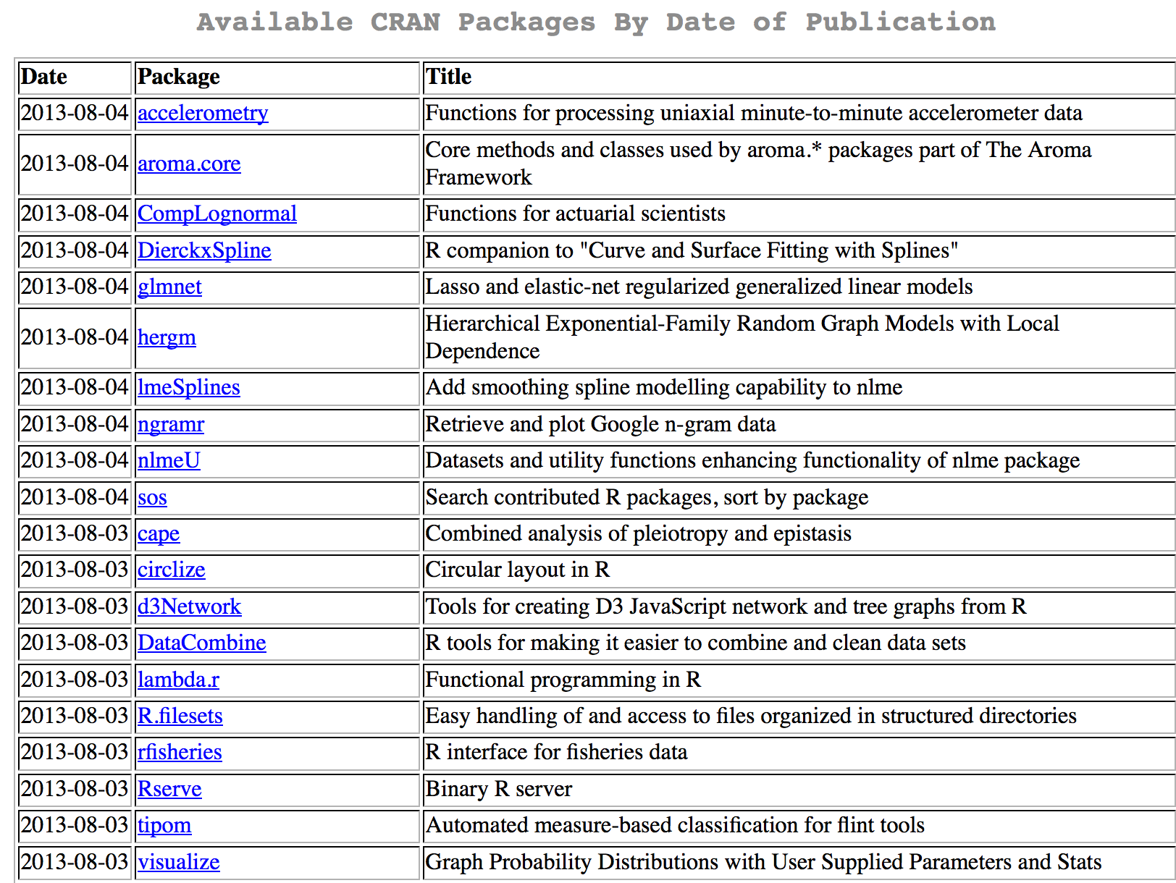
Notes:
These are basically: Too busy; too difficult; no benefit, too weird,

Slide 26
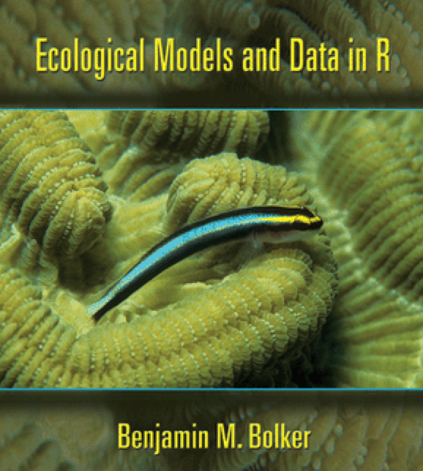
Why “R”?
Scripted, not Gooey*: explicit record of ALL operations, transformations, analyses:
Analyses can be reviewed,
shared, and extended…
Provides durable record
of what you did and how…
* Graphical User Interface; aka GUI

Slide 27
Obstacles to Open Science?
Lack of time and funding
**Lack of easy, useful tools to participate/comply {R, DataONE}
Lack of rewards: money, status, promotion
Breaking from traditional publication model
Notes:
These are basically: Too busy; too difficult; no benefit, too weird,

Slide 28
“Open Science” becoming the new way to do “Science”
{ Open Access, Open Data, Open Notebook, Open Source}
…sharing scientific knowledge, and accelerating scientific discovery in the future…

Slide 29
Some Resources
Nielsen, Michael. 2011. Reinventing Discovery: The New Era of Networked Science. Princeton University Press. 208pp.
http://www.openscience.org/blog/?p=269
http://mitpress.mit.edu/books/open-access

Slide 30
Let’s do some Open Science with R and DataONE!

